Slide 1
BLOCKCHAIN POWERED E-commerce WEB APPLICATION
SUBMITTED BY:
SHASHI GUPTA (1805555)
ROHIT SAMAL (1805547)

Slide 2
Introduction
In our project we are developing an "Blockchain Powered E-commerce Marketplace" using smart contracts. In our web application we are building blockchain powered microservices using smart contracts. In this blockchain-powered ecommerce marketplace we will create smart contracts of services that is needed for ecommerce like purchasing product, adding products, add quantity to products etc. In our website we use custom tokens for payment which we made using blockchain smart contracts.
We are also adding 3d images of products to give customer a detailed feature of a product. For making our web application 3d compatible we are using three.js JavaScript library.

Slide 3
Objectives:
1. Creating a decentralized database for the ecommerce market place.
2. Implement 3d images of products.
3. Implement Blockchain Smart Contracts on a web application.

Slide 4
Methodology/ Planning of work
For planning of work of our web application.
Setup "Blockmason Link" and blockchain network token setup.
Create and deploy smart contracts on a public blockchain.
Create web APIs through LINK to interact with smart contracts.
Create blockchain powered microservices for application to have a series of independently deployable features.
Work on our Front-End to connect with the microservices.
Integrate 3d images of products in front-end.

Slide 5
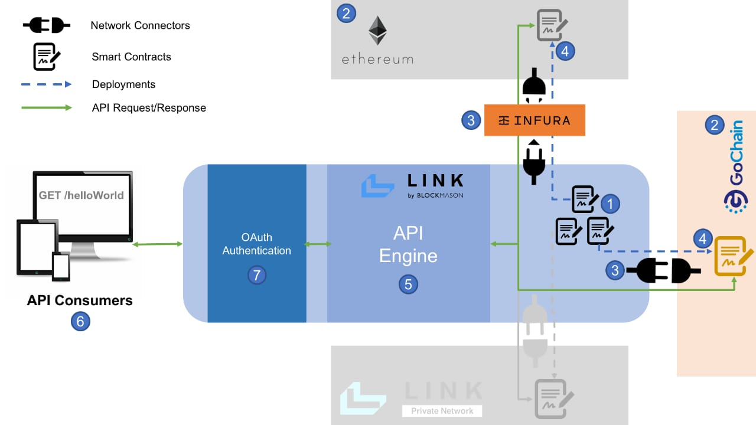
WORKFLOW

Slide 6
Facilities required for proposed work Software Required :-
Visual Studio Code
Front-end :- HTML, CSS, JavaScript
Back-End:- Solidity, Node.js, Three.js

Slide 7
Bibliography
[1] Solidity.[Online]. Available: https://soliditylang.org/
[2] Smart Contracts.[Online]. Available: https://ethereum.org/en/developers/docs/smart-contracts/languages
[3] 3d Model to website using three.js [Online]. Available: https://youtu.be/1TeMXIWRrqE
[4] Blockchain Database. [Online]. Available: https://intellipaat.com/blog/tutorial/blockchain-tutorial/blockchainvs-datab

Slide 8
THANK YOU

